Slide 1
Basic Inter-Process Communication (IPC)

Slide 2
introduction
refers specifically to the mechanisms an operating system provides to allow the processes to manage shared data.
applications can use IPC, categorized as clients and servers, where the client requests data and the server responds to client requests

Slide 3
advantages of inter-process communication
Information sharing - Since several users may be interested in the same piece of information (for instance, a shared file), we must provide an environment to allow concurrent access to such information.
Computation speedup - If we want a particular task to run faster, we must break it into subtasks, each of which will be executing in parallel with the others.
Modularity - We can construct the system in a modular fashion, dividing the system functions into separate processes or threads.
Convenience - Even an individual user can work on many tasks at the same time like a user can be editing, listening to music, and compiling in parallel.

Slide 4
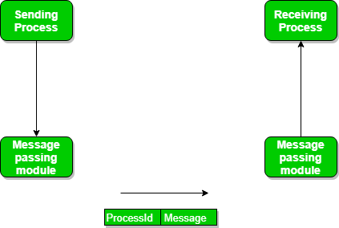

Slide 5
Message passing
processes communicate with each other without using any kind of shared memory. If two processes p1 and p2 want to communicate with each other
they proceed as follows:
Establish a communication link (if a link already exists, no need to establish it again.)
Start exchanging messages using basic primitives. We need at least two primitives: – send(message, destination) or send(message) – receive(message, host) or receive(message)

Slide 6
Communication link
A link has some capacity that determines the number of messages that can reside in it temporarily for which every link has a queue associated with it which can be of zero capacity, bounded capacity, or unbounded capacity.
In zero capacity, the sender waits until the receiver informs the sender that it has received the message.
In non-zero capacity cases, a process does not know whether a message has been received or not after the send operation. For this, the sender must communicate with the receiver explicitly

Slide 7
Synchronous and asynchronous message passing
Synchronous message passing means that the message is passed directly between the sender and the receiver without being buffered in-between. This requires the sender to block until the receiver has received the message, before continuing doing other things. Similarly, a receiver calling a receive operation blocks until a message is sent.
Asynchronous message passing involves buffering the message between the sending and receiving process. This allows a sender to continue doing other things as soon as the message has been sent.

Slide 8
sockets
another of the ways to manage inter-process communication is by using sockets. They provide point-to-point, two-way communication between two processes. Sockets are an endpoint of communication and a name can be bound to them. A socket can be associated with one or more processes.

Slide 9
Types of Sockets
The different types of sockets are given as follows −
Sequential Packet Socket: This type of socket provides a reliable connection for datagrams whose maximum length is fixed This connection is two-way as well as sequenced.
Datagram Socket: A two-way flow of messages is supported by the datagram socket. The receiver in a datagram socket may receive messages in a different order than that in which they were sent. The operation of datagram sockets is similar to that of passing letters from the source to the destination through a mail.
Stream Socket: Stream sockets operate like a telephone conversation and provide a two-way and reliable flow of data with no record boundaries. This data flow is also sequenced and unduplicated.
Raw Socket: The underlying communication protocols can be accessed using the raw sockets.

Slide 10
Key benefits of sockets
You can connect a simple client to them for testing (manually enter data, see the response). This is very useful for debugging, simulating and blackbox testing.
You can run the processes on different machines. This can be useful for scalability and is very helpful in debugging / testing if you work in embedded software.
It becomes very easy to expose your process as a service

Slide 11
Drawbacks of sockets
Overhead is greater than IPC optimized for a single machine. Shared memory in particular is better if you need the performance, and you know your processes are all on the same machine.
Security - if your client apps can connect so can anyone else, if you're not careful about authentication. Data can also be sniffed if you're not encrypting, and modified if you're not at least signing data sent over the wire.

